Slide 1
Reconstruction of Maps from Satellite Image
Faculty of Kinesiology
& Health Studies
DATE 24, 2022

Slide 2
Content
Outline
Introduction
Problem Specification
Database
Background
Implementation of CGAN
Approach
Evaluation
Conclusion

Slide 3
Outline
It is hard to evaluate or segment the object or road from the satellite view.
Using Conditional GAN, we have generated map images from satellite images
Our approach is based on pix2pix architecture.
We received the minimal loss from our proposed architecture of discriminator.
3

Slide 4
Introduction
Generation of maps is very valuable and time consuming process.
In every domain, we rely on maps i.e. especially in sectors like cab services (like Uber and Lyft), food delivery companies, security agencies like CIA, RAW, KGB and many other sectors.
Currently, to generate human-readable map there is issue of latency. So, to reduce this issue we have automated this process.
4

Slide 5
Problem Specification
Currently, we rely on GPS sensors mounted drones, UAVs and other variety of devices to collect geo-spatial data and then we combined it to create maps.
This process of generating human-readable maps is time consuming which leads to the issue of latency.
We need to automate this process such that we can directly convert satellite images into human-readable maps which solves the problem of latency.
5

Slide 6
Database
The dataset is collected by UC Berkeley researcher Taesung Park using Google Maps API to get both satellite images and map images from the New York City Park.
This dataset contains two directories namely train and val.
It contains 1096 concatenated satellite images corresponding to their map image.
The actual size of image is 1200x600 which is later preprocessed and converted into 256x256 dimensions.

Slide 7
Background
Image to Image Translation with Conditional Adversial Networks [2018]
Comparing GANs for Translating Satellite Images to Maps [2021]
GeoGAN: A Conditional GAN with Reconstruction and Style Loss to Generate Standard Layer of Maps from Satellite Images [2019]

Slide 8
Background - Continued
CycleGAN: It improves the issues of Pix2Pix GAN by creating it less selective with respect to the data available but it can’t able to detect all the necessary features.^{[2]}
Real-Valued Non-Volume Preserving Normalizing Flow Model (RealNVP) is valuable in the task of generating realistic photo and we can modify the generator of the conditional GAN in various ways to get the optimum results in our task using this reference.^{[3]}

Slide 9
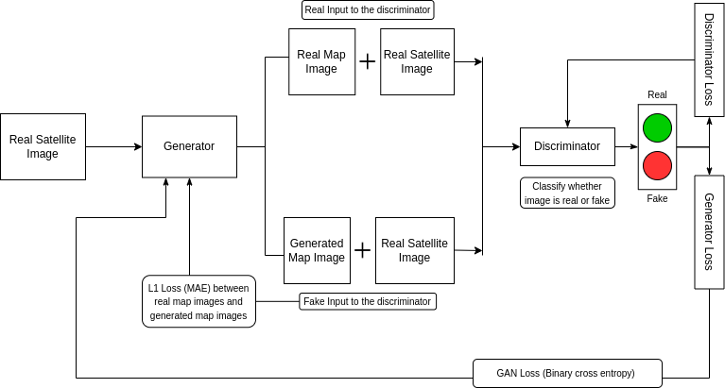
Implementation of cGAN

Slide 10
Approach
We utilized the concept of conditional GAN and used pix2pix architecture as a reference for image to image translation of satellite images to map images.
We have used U-NET architecture in Generator model which will generate map images.
Then we concatenated generated map images with real satellite images and sent it to discriminator with pair of real satellite and map images.

Slide 11
Approach - Continued
For discriminator model we have modified PatchGAN to get better results.
Discriminator will classify whether given image is real or fake and based on that it will generate loss and will try to improve itself in every step to reduce this loss.
We have also calculated L1 Loss which is a MAE between real map images and generated map images and use it to optimize generator in each training step.
We have used L1 Loss and GAN loss with 100:1 ratio.
We have trained our GAN with 10 epochs.

Slide 12
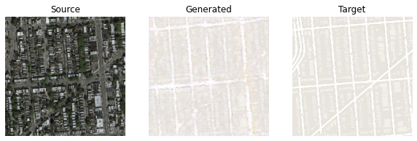
Result
Generated Image using validation dataset

Slide 13
Evaluation
For evaluation we have calculated following losses:
L1 Loss: MAE between generated map image and real map image.
Discriminator Loss: Generated by evaluating the real and fake images classified by the discriminator model.
GAN Loss: Generated by evaluating the combined model of generator and discriminator.

Slide 14
Average Loss
Type of Loss | Average Loss
Loss 1 (L1) | 0.084
Discriminator Loss (L2) | 0.088
GAN Loss | 13.181

Slide 15
Conclusion
We have utilized conditional generative adversarial network to generate human-readable map images from satellite images. Our generator will take satellite image as input and it will generate map image. We have used U-NET architecture for our generator which is used for image segmentation and proposed a new architecture of discriminator model by modifying existing PatchGAN architecture.

